Slide 1

Expanding Access Through
AP Computer Science
July 23, 2026

Slide 2

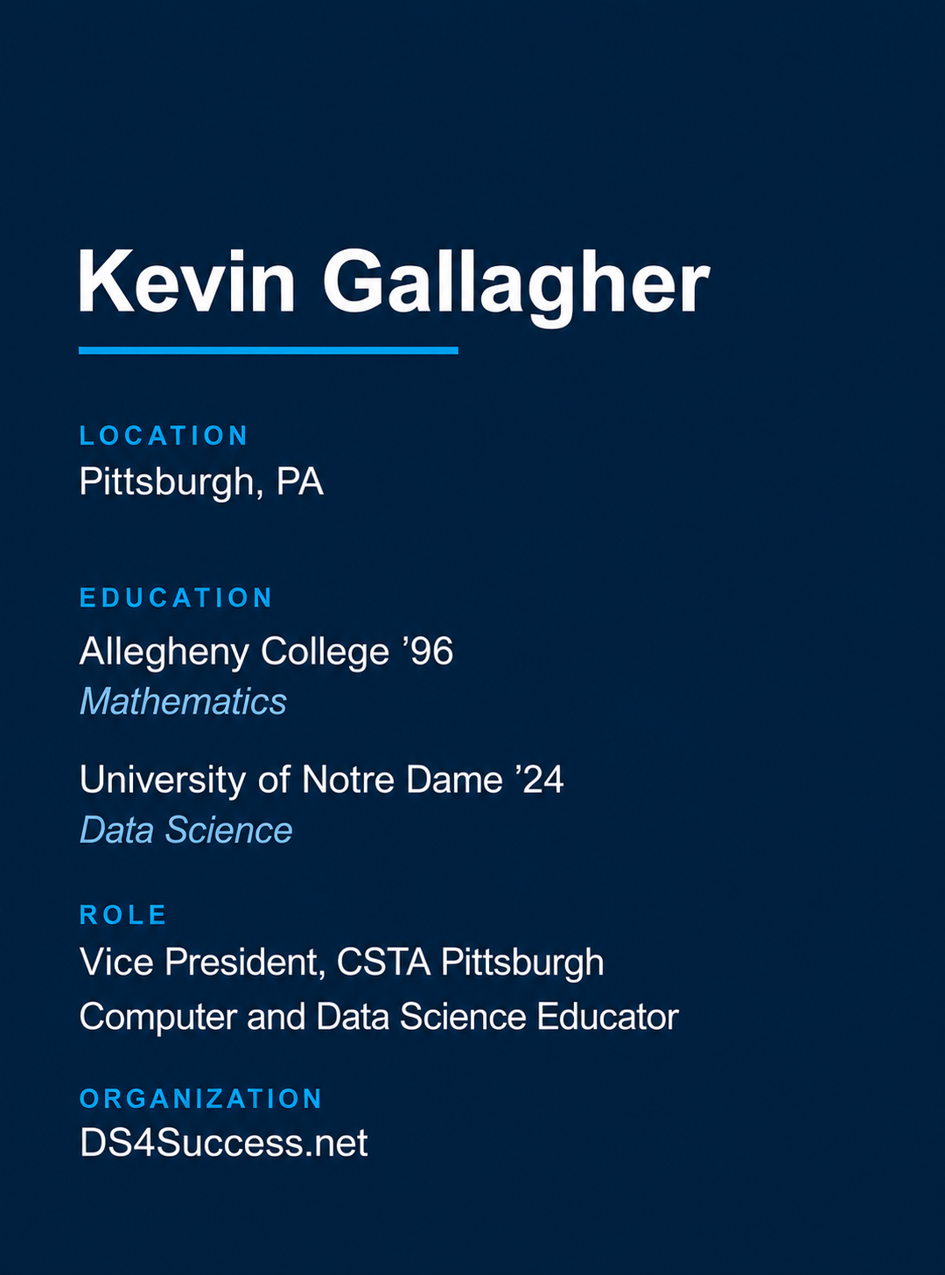

Slide 3

What’s on Tap?
Play Rock, Paper, Scissors
Explore the Resources
Uncover the Data Story
Take It to Your Classroom

Slide 4
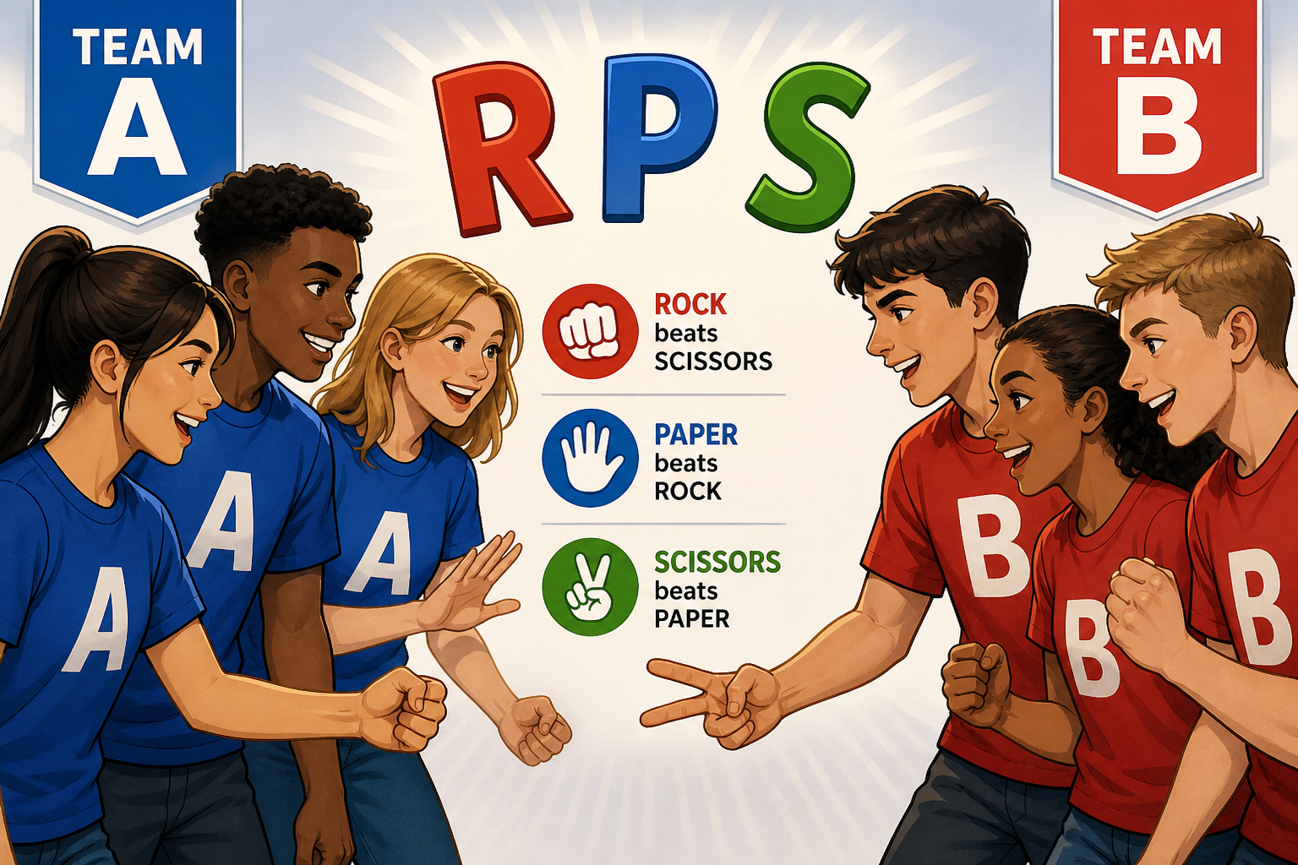
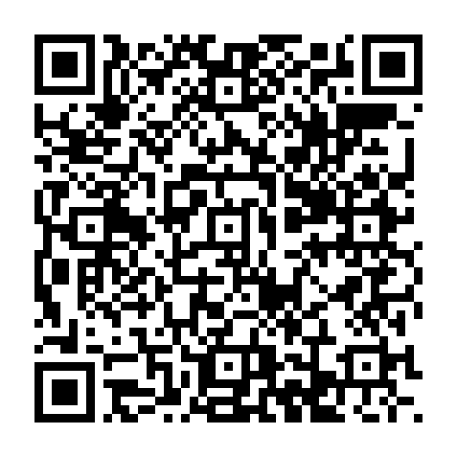
Rock, Paper, Scissors
Find a neighbor and randomly decide who will be on Team A and who will be on Team B. I will assign you each a number.
Play EXACTLY 27 times (not 26, not 28)
Keep track of how many times each team wins and how many ties you have
When you are done, circle around the room and find other members of the opposing team and play again
Record your findings in the Google Form
Notes:
ADD GOOGLE SHEEET???

Slide 5
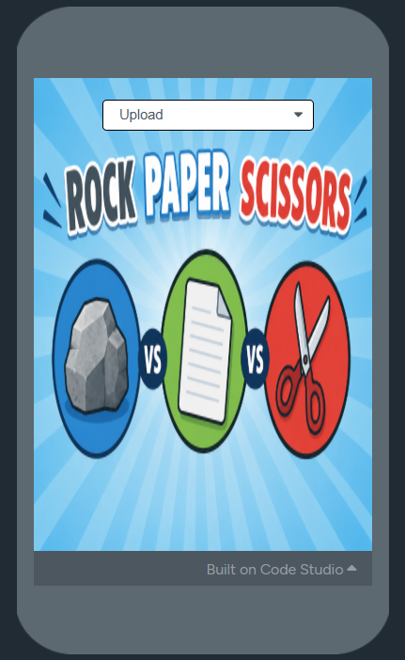
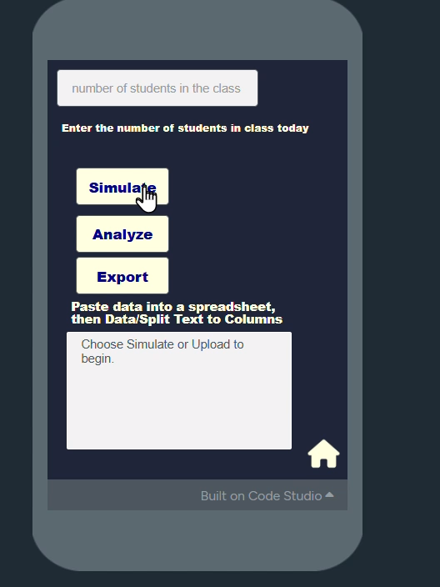
Resource #1a
App Lab
AP CSP Video

Slide 6
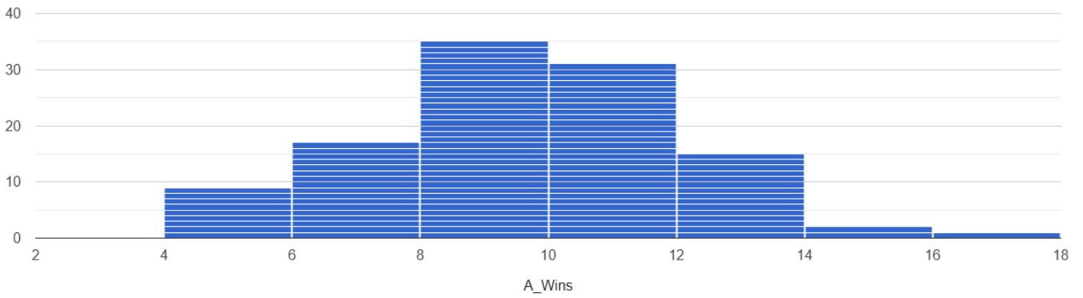
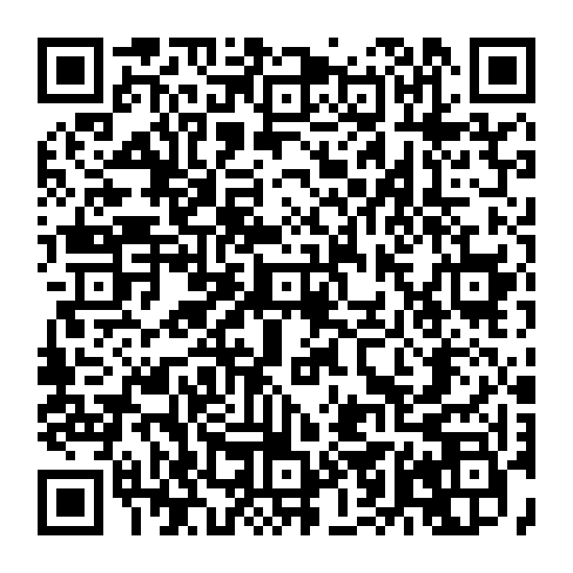
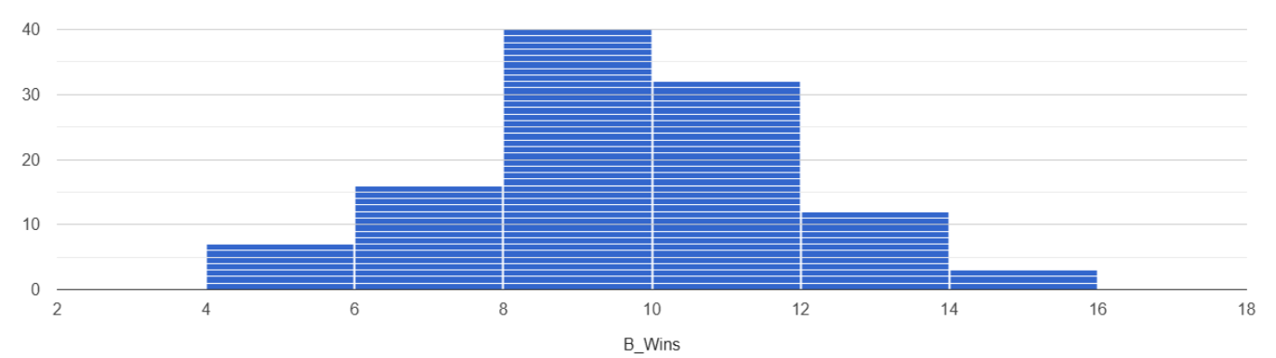
Resource #1b
App Lab
Mean A Wins: 9.07
Median A Wins: 9.00
Mean B Wins: 9.15
Median B Wins: 9.00

Slide 7
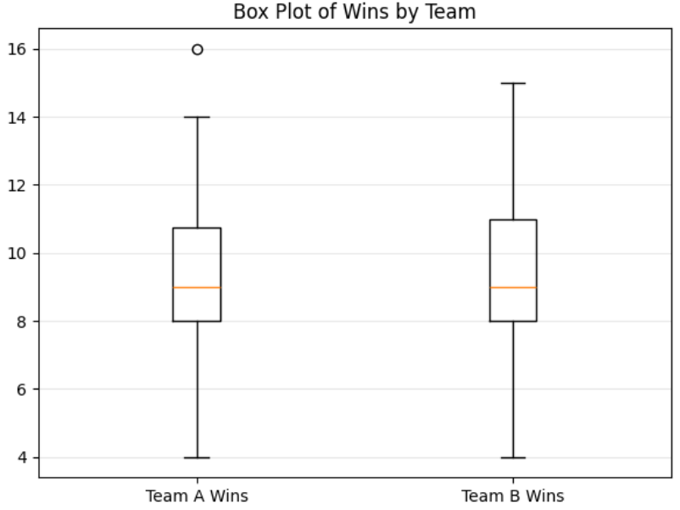
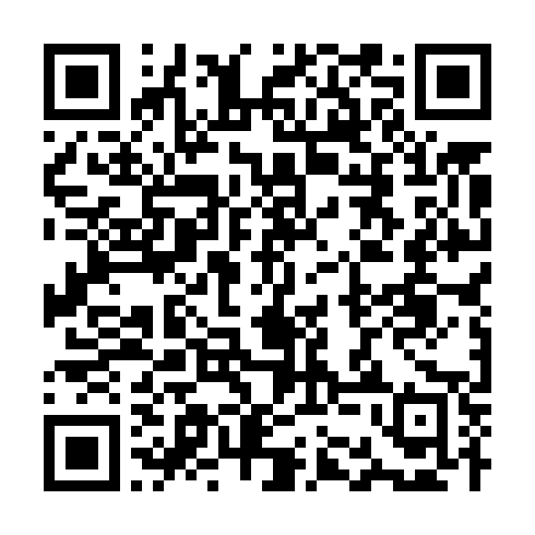
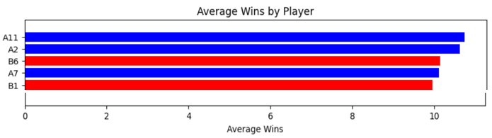
App Lab
Resource #2a
Python

Slide 8
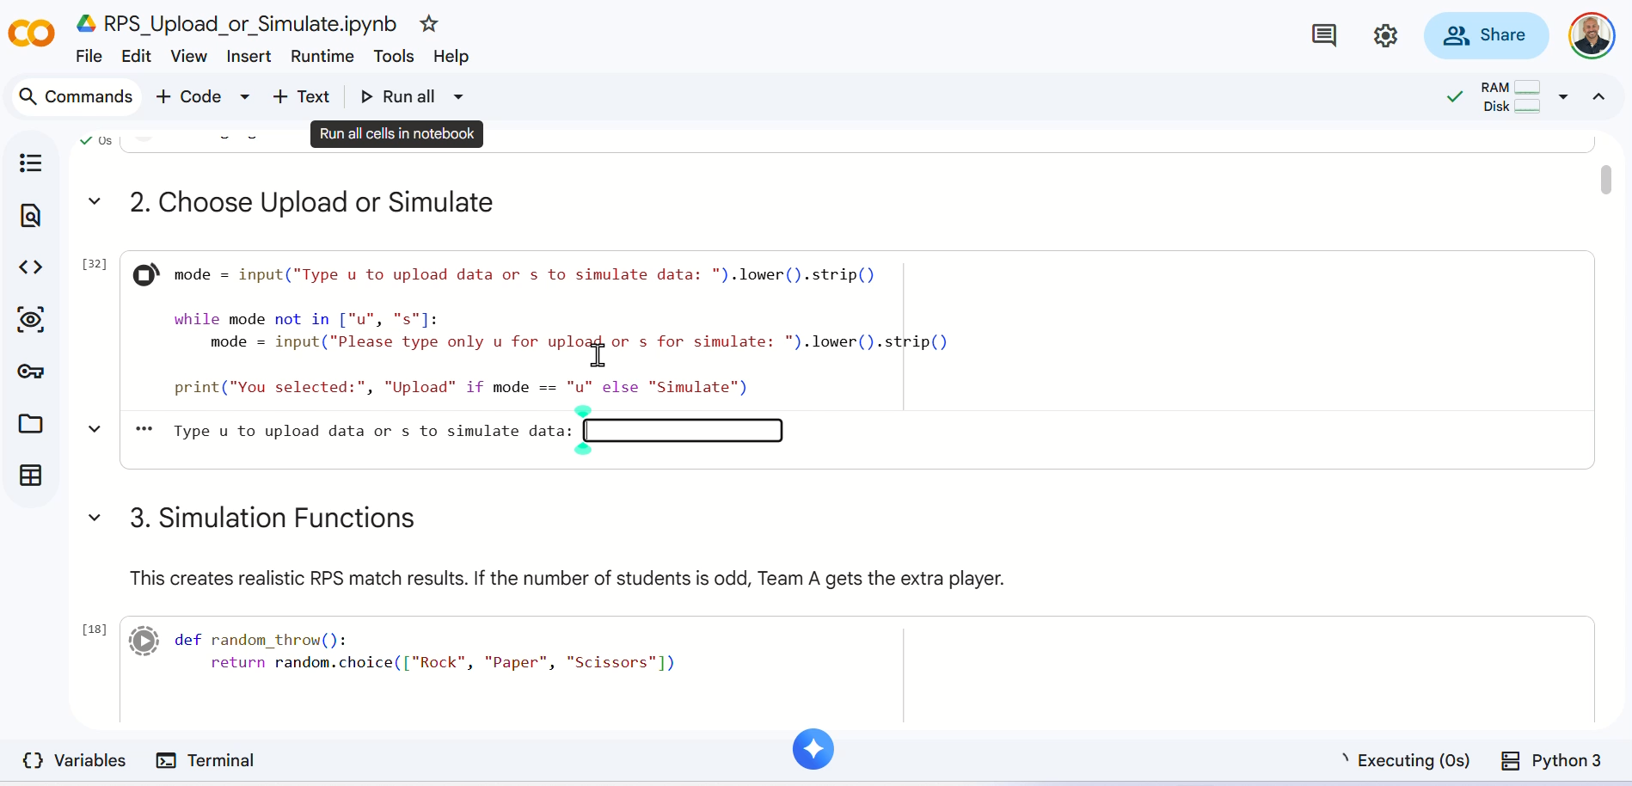
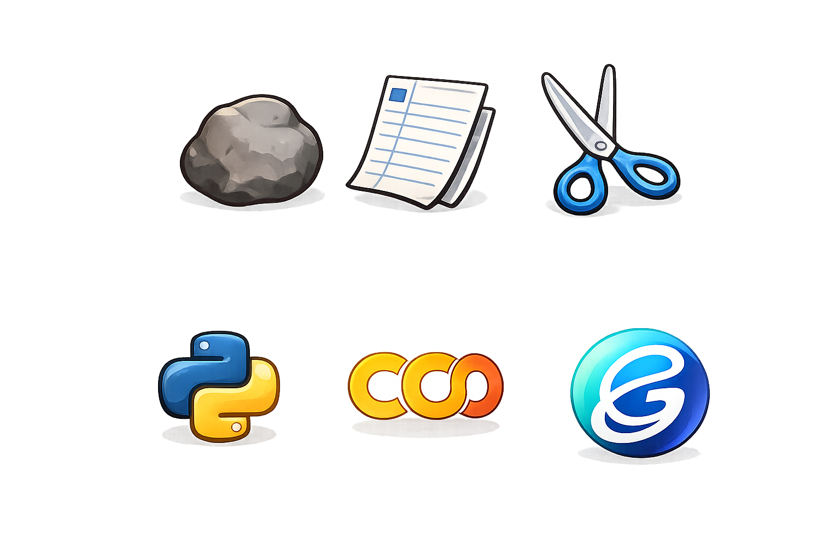
Resource #2b:
Python
AP CSP Video
Intended Audience: CS/DS/Stats Teachers
Purpose: Entertainment or Education
Inputs: U for Upload, S for Simulation
Outputs: EDA for R,P, S
Note: If you get an error while coding in
Google Colab, you can click on Gemini
to suggest a solution. You can accept
the recommendation or accept and rerun
your code.

Slide 9
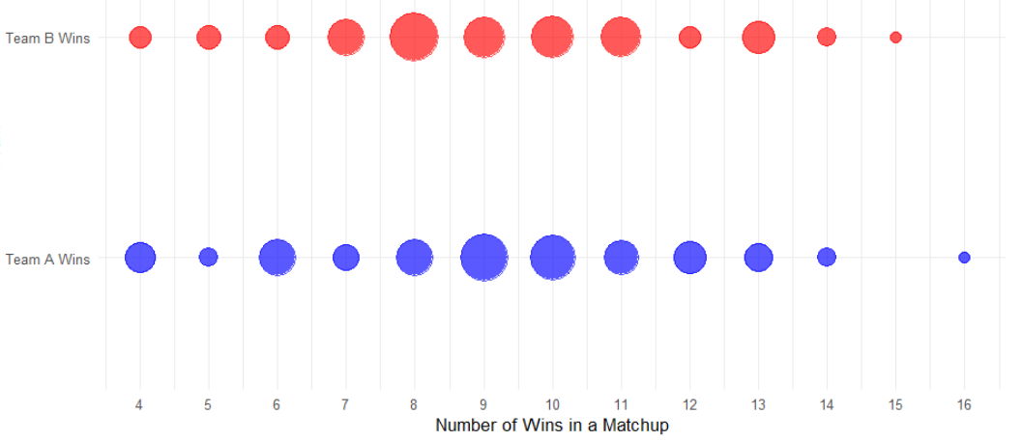
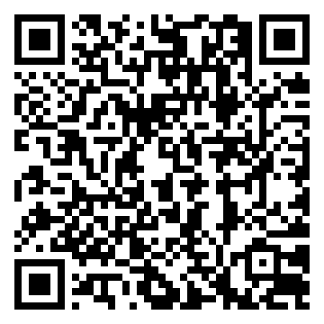
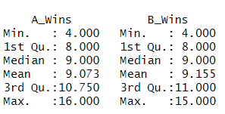

Resource #3
R Studio

Slide 10
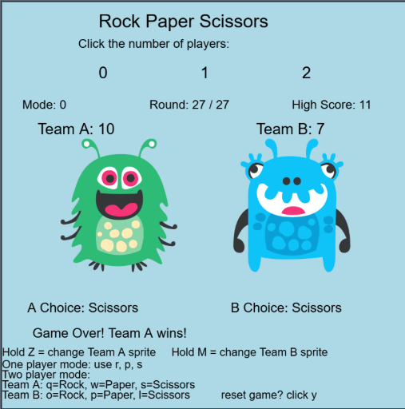
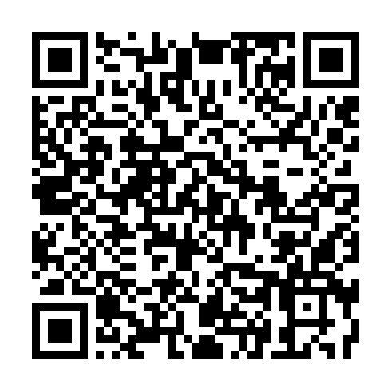
App Lab
Resource #4
Game Lab

Slide 11
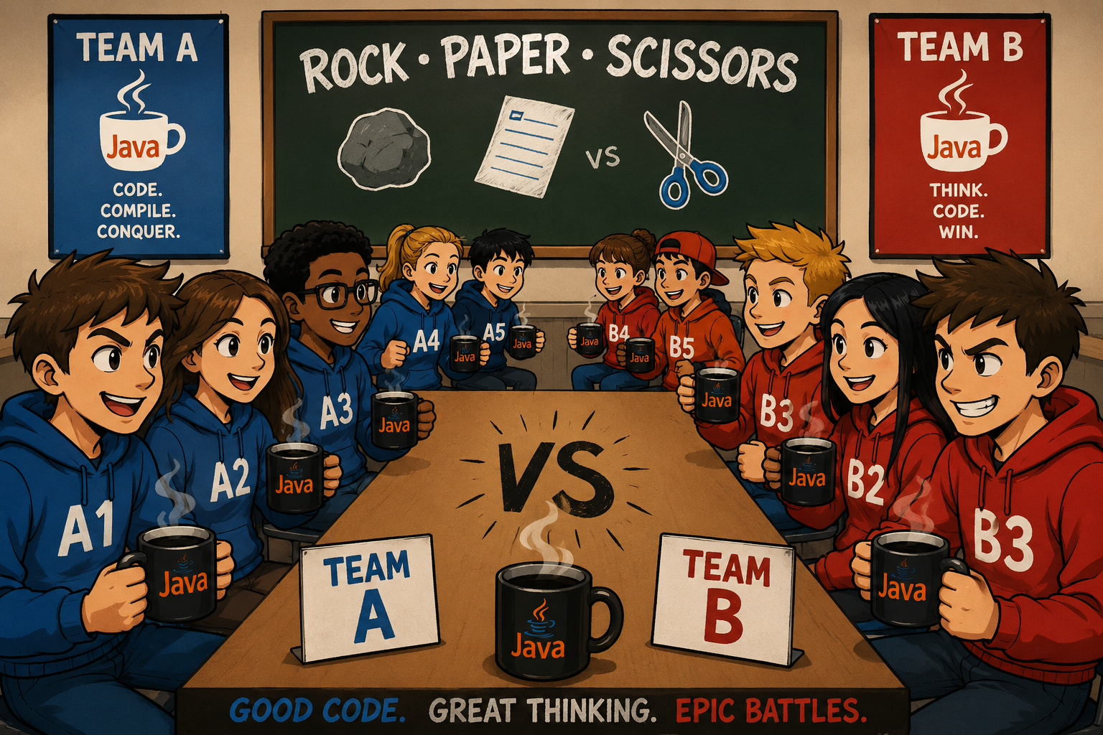
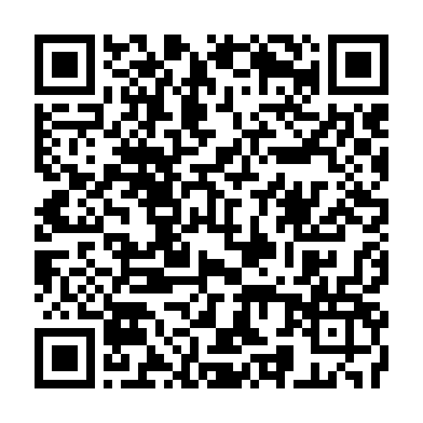
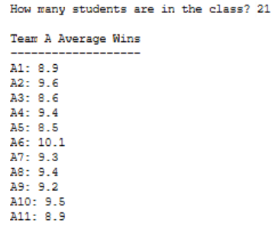
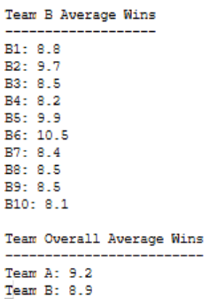
Resource #5
AP CSA/CSP
Java

Slide 12
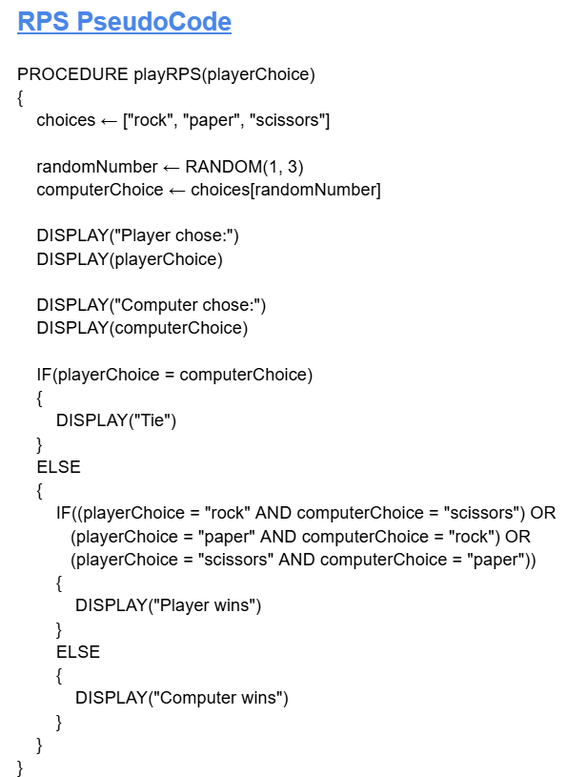
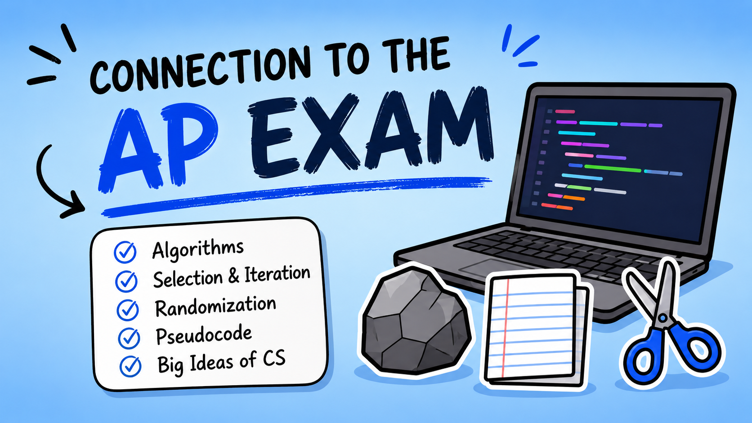
Resource #6
AP CSP Pseudocode

Slide 13
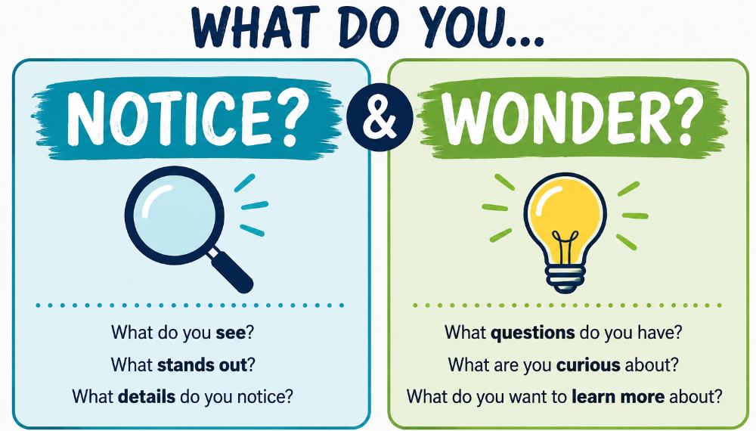

Slide 14
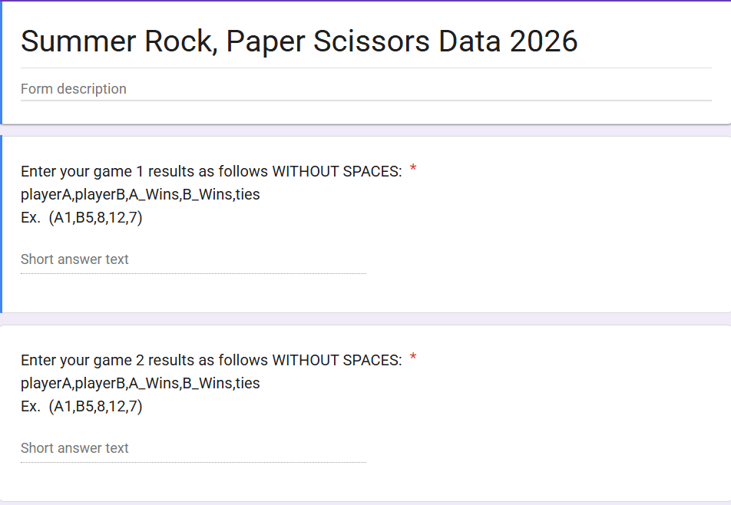
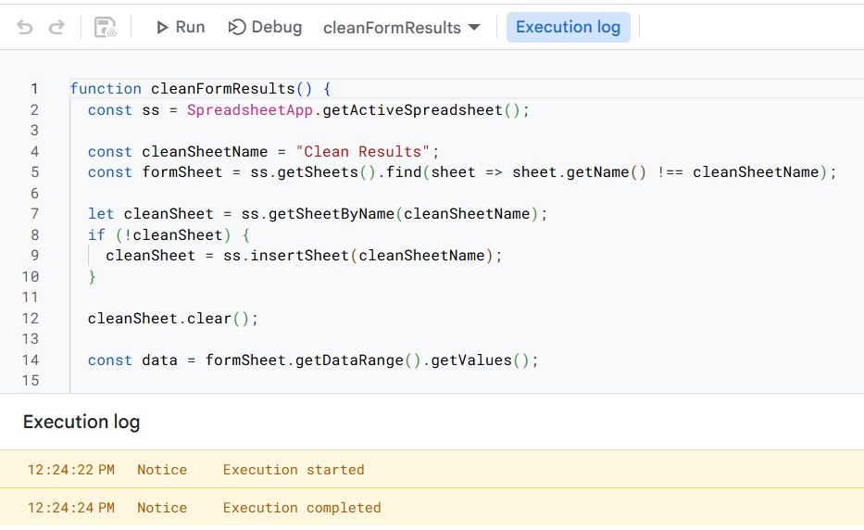
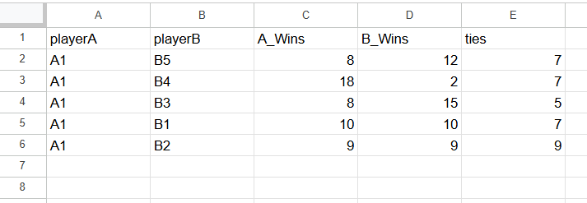
How to Clean the Data?

Slide 15
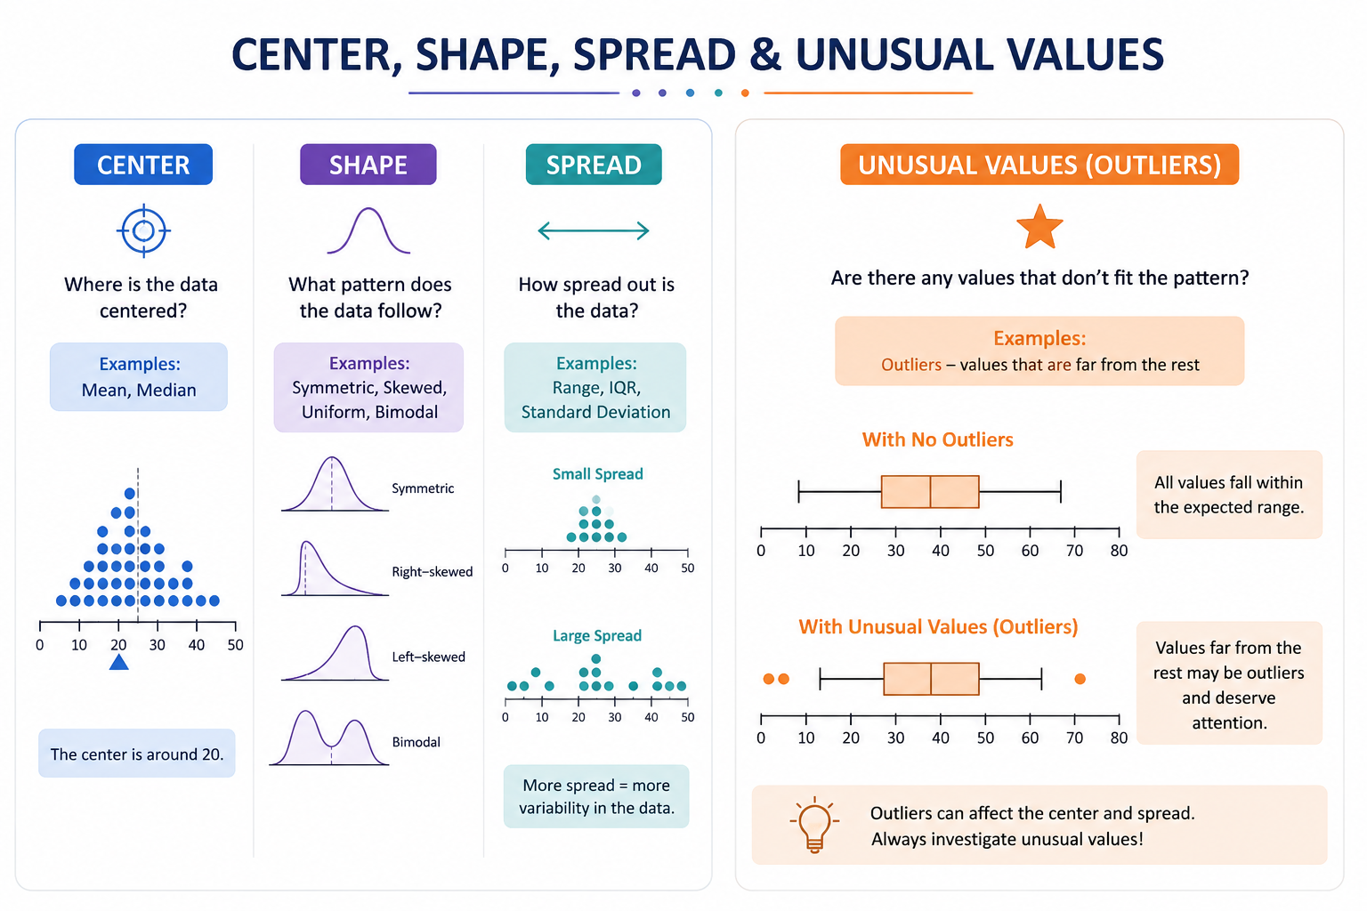
Crispy Chicken Nuggets Sold Separately

Slide 16


Slide 17
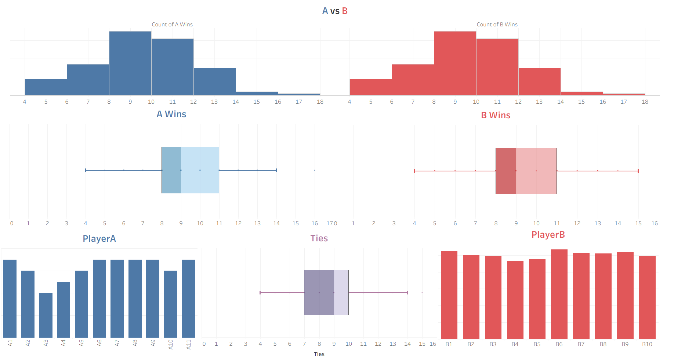
TABLEAU DASHBOARD
COMING SOON….DS2Impress.net

Slide 18

Thank You!!!
Kevin Gallagher
KevinG@DS4Success.net
DS4Success.net
DS2impress.net

Slide 19
